Slide 1
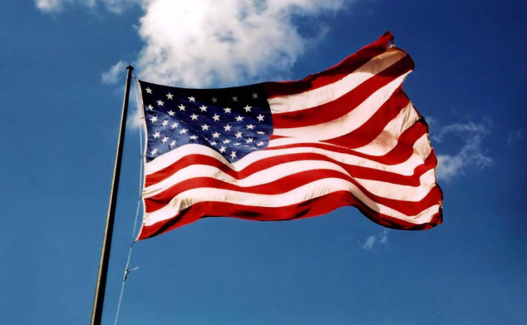
Competing Visions for America:
Impact of extreme ideologies in The United States.

Slide 2
First Amendment:
Congress shall make no law respecting an establishment of religion or prohibiting the free exercise thereof; or abridging the freedom of speech, or of the press; or the right of the people peaceably to assemble, and to petition the Government for a redress of grievances.

Slide 3
The five core freedoms that are foundational to American Civic Life.
Freedom of Speech
Freedom of Religion
Freedom of Press
Freedom of Assembly
Freedom to Petition

Slide 4
Here is a list of the few countries that have 90% or more Muslim population.
Pakistan 96% Sudan 90+% Palestine 97%
Somalia 99% Jordan 95% Syria 90+%
Bangladesh 90%, Tunisia 99%
Iran 99%, Libya 96%
Turkey 98%, Senegal 95%
Eygpt 90+%, Marutania 99%
Algeria 99%, Mali 99%
Morocco 99%, Niger 98%
Saudia Arabia 99%, Djibouti 94%
Iraq 95%, Comoros 98%
Afghanistan 99%, Tajikistan 95%
Yemen 99%, Turkmenistan 90%

Slide 5


Slide 6
