Slide 1
Fox Valley Initiative
April 1, 2024

Slide 2
AASD Vision
Working together, students, families, staff, and community will ensure that each graduate is academically, socially, and emotionally prepared for success in life. Every Student, Every Day.
Notes:
Success drives our decisions…we are constantly asking ourselves how can we improve so our students have more success. Means something different to each of our 15,200 students

Slide 3
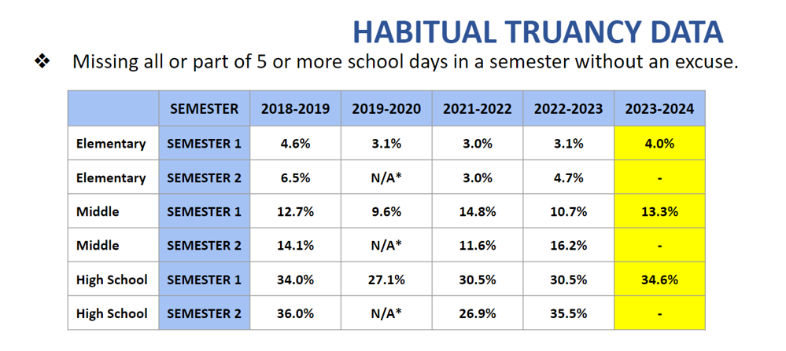
Attendance Concerns
Notes:
History of truancy law and truancy court went away in 2019

Slide 4
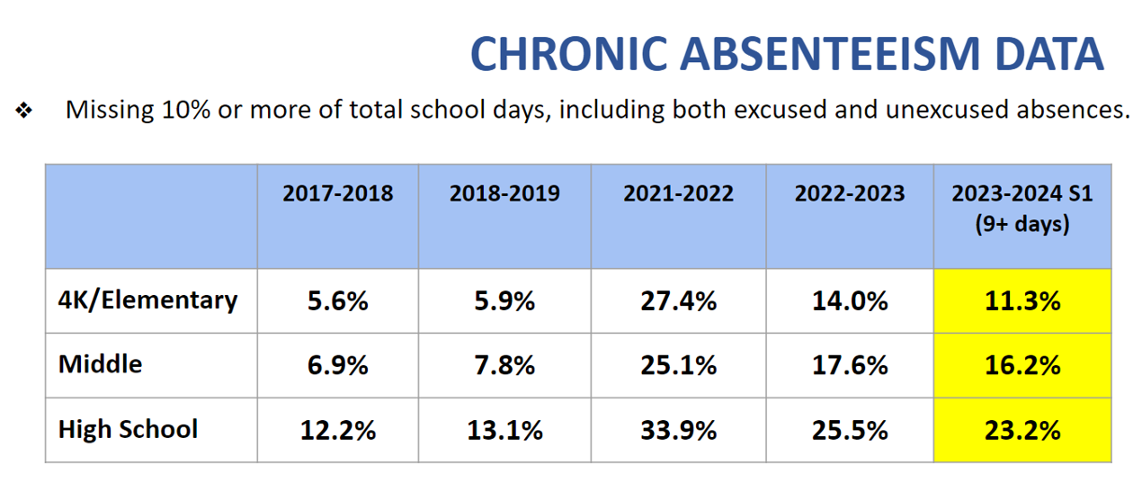
Elementary = 875 students Middle = 313 students High = 1,054 students
Notes:
This is our bigger concern

Slide 5
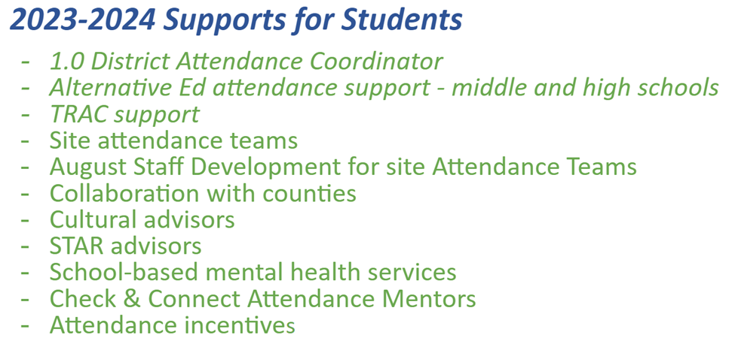
Notes:
This is our bigger concern

Slide 7
Behaviors
4, 5 and 6 year old students
Phone usage
Student loitering
Acceptance of marijuana by adults has led to student use
Use as early as 4th grade
Synthetic marijuana
Fentanyl
*Consequences

Slide 8
AASD Demographics

Slide 9
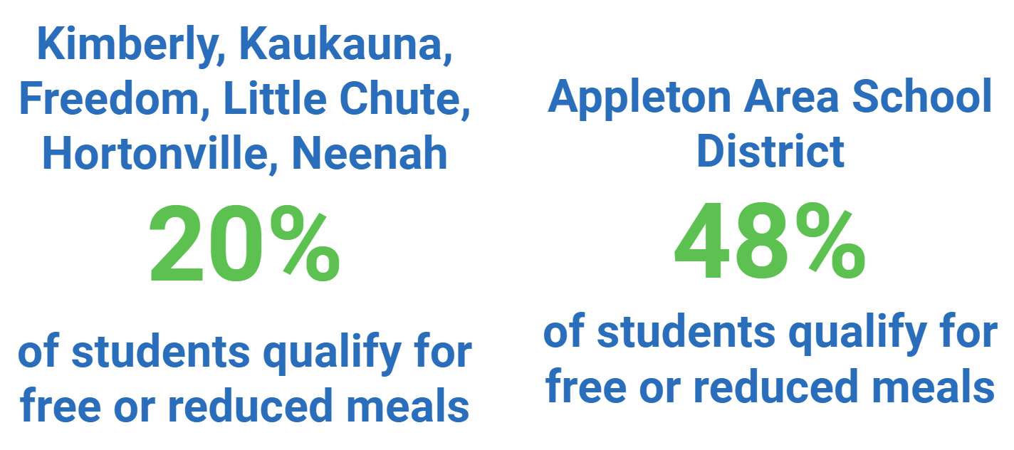

Slide 11
Notes:
Under the umbrella of EL are newcomers, many with refugee backgrounds…Last year we had 85 the entire year, this year 88 in first semester alone from 18 different countries…

Slide 12
Who is not finding “success” in our district?
Students with Special Education needs
Students learning English as their second language
Students living in poverty
Kindergarten
9th grade
African-American, Latino, and American Indian
DEI - Diversity, Equity, and Inclusion

Slide 13
AASD Vision
Working together, students, families, staff, and community will ensure that each graduate is academically, socially, and emotionally prepared for success in life. Every Student, Every Day.
Notes:
Some students need more from us if they are going to find success as adults…I am going to live in this community for 30 more years…some of these kids may need to be my doctor, nurse, mechanic, plumber

Slide 14
DEI - Diversity, Equity, and Inclusion
Success
Literacy is our equity strategy
“We aren’t going to hug our kids into poverty”
Never heard of CRT until recently

Slide 15
30% of AASD 3rd-graders reading on grade level
Seven years of declining scores

Slide 16
Literacy Audit

Slide 19
Word Recognition - Foundational Skills
Language Comprehension
Notes:
Triumph - early results have been very positive and excited to fully implement in fall

Slide 20
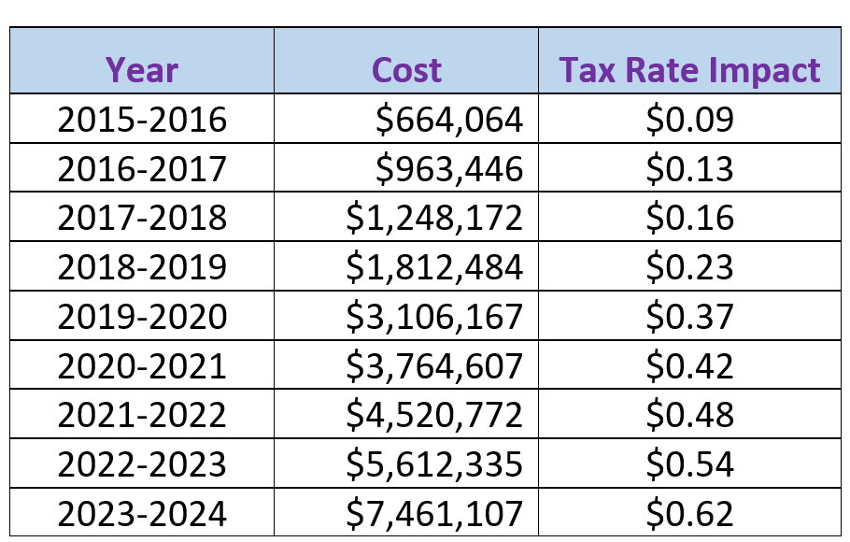
Private School Vouchers

Slide 21
Private School Vouchers
A taxpayer with property valued at $200,000 paid $124 to private schools this year
872 AASD students
31% of private school enrollments
Family of four qualifies at $68,000 or less

Slide 22
For every 100 AASD students
12 need EL services
18 need special education services
70 need no additional services

Slide 23
100 students at $11,000 equals $1.1 million
18 need special education services ($22,000 per student)
12 need EL services ($16,000 per student)
70 need no additional services ($7,500 per student)

Slide 24
90 students at $11,000 equals $990,000
18 need special education services ($22,000 per student)
12 need EL services ($16,000 per student)
60 need no additional services ($7,500 $6,800 per student)

