Slide 1
What is WILL doing to save Wisconsin? Miranda Spindt
Policy Associate

Slide 2
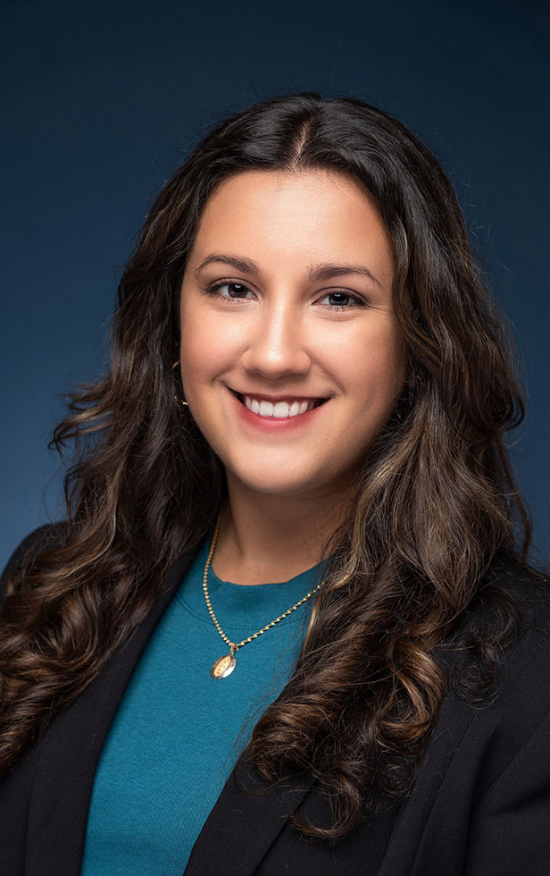
About Me
Graduated from Marquette University with a B.A. in Political Science and Economics.
Earning a Master of Public Administration with a concentration in Data Analysis and Analytics from Norwich University.
I interned at WILL for one year and have been in a full-time role for 1.5 years.
My work is centered on healthcare and education policy.
Twitter: @miranda_spindt

Slide 3
About WILL
WILL is a non-profit law and policy center in Milwaukee.
Through education, litigation and participation in public discourse, we work to advance limited government, free speech, transparency, and education reform.
We provide timely and comprehensive policy research to advance education reform, election reform, economic freedom, and policies to advance limited government.
Craft model legislation and advocate for bills in the state capitol.

Slide 4
Recent Litigation Wins
B.F. v. Kettle Moraine School District: A Waukesha County Judge ruled in our favor supporting parents’ constitutional rights to raise their own children. The order also enjoined the school district from “refer[ring] to students using a name or pronouns at odds with the student’s biological sex, while at school, without express parental consent. The decision sets a significant precedent that will help achieve greater wins across the country.
Britto v. ATF: WILL won this critical Second Amendment case via preliminary injunction, blocking President Biden’s illegal gun grab on behalf of our clients. WILL was the first organization to file a lawsuit against the federal rule.
Nuziard et al. v. MBDA: WILL’s groundbreaking lawsuit challenged the Biden Administration’s racially discriminatory Minority Business Development Agency programming. Securing a preliminary injunction here reaffirmed that the government cannot discriminate on the basis of race, as established in the Constitution.
Teigen v. WEC: WILL won at the Wisconsin Supreme Court, ending the practice known as “ballot harvesting,” and using unstaffed ballot boxes.

Slide 5
The Policy Team
Provide comprehensive, reliable, and timely policy research.
Focus on education, healthcare, regulatory reform, and economic opportunity.
Educate legislators and citizens on important issues and participate in public discourse.
Advance good public policy initiatives while protecting against bad ones.

Slide 6
Recent Policy Wins
Our team led in opposing state legislation that regulates liquor licensing in such a way that effectively bans wedding barns.
Governor Tony Evers signed public school spending transparency legislation (AB 378 / SB 373) into law initiating a new process to shed more light on how public schools spend public dollars. WILL supported the bipartisan legislation.
The Restoring American Education Initiative is a national effort to empower parents, teachers, and school board members to create sustainable and meaningful change within the local school district. Our model policies have been considered and adopted by several districts and received national attention.

Slide 7
The School Scorecard
https://will-law.org/school-scorecard/

Slide 8
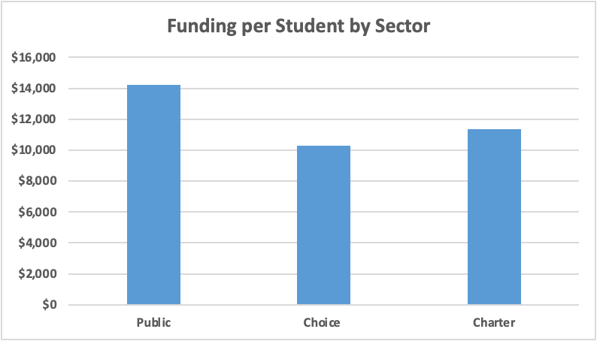
School Choice Updates
Governor Evers signed 2023 Act 11– an amazing bi-partisan legislation that increased per-pupil funding for school choice. This is an important step towards achieving universal school choice.
Wisconsin now has the 7th closest gap between funding for public schools and schools in its school choice programs at approximately 76%. Closing the funding gap has long been a key principle of WILL’s education policy agenda.

Slide 9
School Choice Updates
Kirk Bangstad, through his Minocqua Brewing Company PAC, has filed a lawsuit against the school choice program in hopes the WI Supreme Court will find it unconstitutional and stop the program.
WILL filed an amicus brief and a motion to intervene in a lawsuit seeking to overturn Wisconsin’s widely popular and successful school choice program. WILL’s motion and amicus was filed on behalf of 22 clients—representing parents of students enrolled in choice and charter schools, schools across Wisconsin, and organizations that advocate for educational freedom.
This would put 63,000 choice and charter students back into failing public schools.
1,035 students in Green Bay.
Governor Evers' administration has even urged the Supreme Court not to take the case, preferring that it start in lower courts .

Slide 10
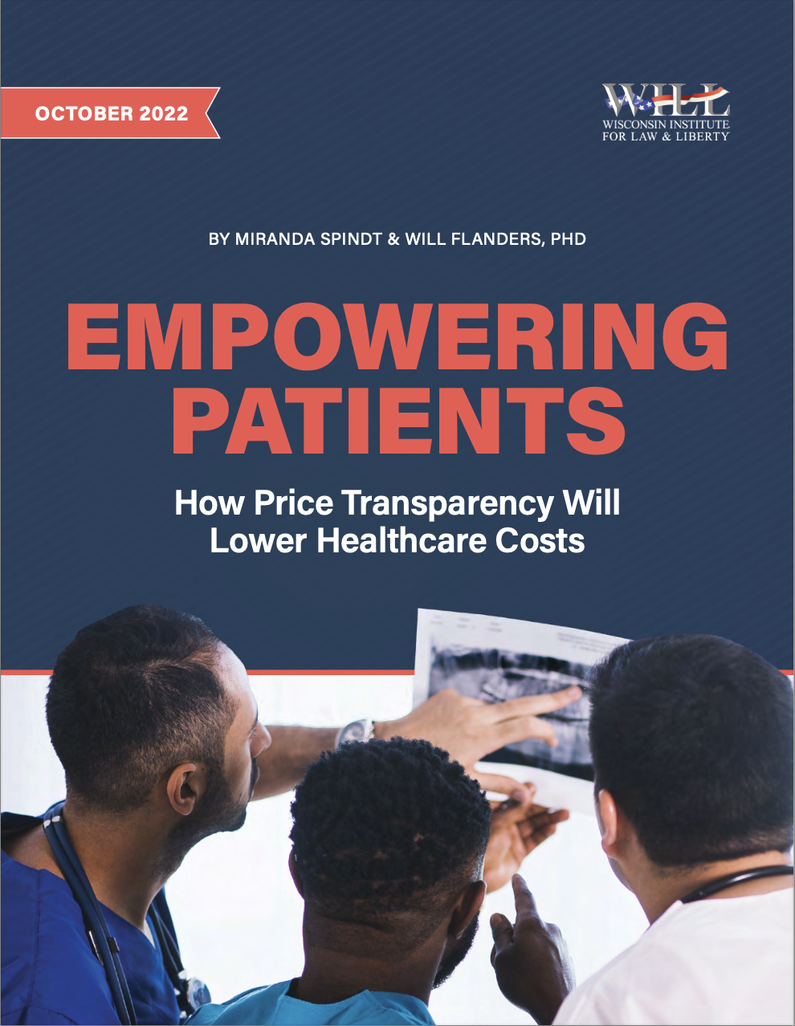
https://will-law.org/will-releases-new-healthcare-agenda-to-policymakers/
https://will-law.org/pricetransparency/

Slide 11
The State of Healthcare in WI
73% of Wisconsinites overall think that Healthcare is a top issue for legislators.
Almost half of Wisconsinites—47%— have delayed or completely avoided receiving healthcare due to fear of cost.
Four in five Wisconsinites are worried about being able to afford healthcare costs in the future.
Only 25% agree or strongly agree that we have a great healthcare system in the US.
https://www.healthcarevaluehub.org/application/files/6715/8352/0434/Hub-Altarum_Data_Brief_No._58_-_Wisconsin_Healthcare_Affordability.pdf

Slide 12
The State of Healthcare in WI
Wisconsin has the 4th highest hospital costs according to the Rand Corporation.
On average, Wisconsinites spend $10,000 per person, per year on healthcare.
Prices vary significantly depending on your insurance and provider.
In Wisconsin, a blood test for clotting can range from $17.50 to $135.47 and a joint replacement (hip or knee) can cost between $17,513 and $65,927.

Slide 14
How did healthcare get here?
Healthcare is typically considered an "inelastic good" meaning that people are likely to receive the care they need no matter how much it costs. This is why insurance is important.
However, insurance coverage and our reliance on it has grown to a point that severely interrupts the "supply vs demand" dynamic we are used to in almost every other sector of the economy.
There are many reasons for our ever-rising healthcare costs, but a lot of it boils down to the fact that consumers have almost no control over their healthcare cost decisions.

Slide 15
How did healthcare get here?
Prices are not determined by what consumers are willing to pay. Hospitals, insurance companies, and other third parties decide the prices and negotiate how much of it is covered by the insurance vs the consumer.
Patients have limited, if any, knowledge of what they will pay before receiving a medical good or service.
Government intervention is also a large factor in increasing costs.
Ex: Obamacare Medical Loss Ratio (a.k.a. The 80/20 Rule)
There is no free market in healthcare.
There is no free market in healthcare.

Slide 18
Questions:
Have you ever tried to get a price estimate for your healthcare before receiving it?
Have you used a price comparison tool to do so?
Would knowing the price change how you make healthcare decisions?

Slide 19
Price Transparency
This is the basic idea that patients should be able to know what they are going to pay for their healthcare before they receive it.
80% of healthcare services and treatments are "shoppable". This means they can be scheduled ahead of time and consumers should be empowered to find what they need at the best price.
https://www.cms.gov/healthplan-price-transparency/resources/500-items-services
This policy is supported by 90% of voters according to Patient Rights Advocate.
It has been passed in 33 states with bipartisan support. Not yet in WI.

Slide 20
Price Transparency
The Trump Administration implemented a federal hospital in 2019 that requires them to share the prices for 300 "shoppable" services in both a machine-readable file and a consumer-friendly display.
The penalties were increased from $300 a day to up to $5,500 a day depending on bed count in 2022.
Still today, only 24.5% of hospitals nationwide, and 45% in Wisconsin, are complying with the federal rule. Only 14 hospitals have been fined so far by CMS.

Slide 21
Price Transparency in WI
Senate Bill 328 would codify the federal rule in Wisconsin and ensure enforcement of price transparency in our state.
We would not have to rely on the federal government to enforce the rule on Wisconsin hospitals.
Price Transparency would be protected in Wisconsin if the federal rule were ever lifted.
We expect that private third parties will use the complete information to create easy to use tools for patients.
Ex: Kayak for comparing flight and hotel prices
Laso Health and Turquoise Health

Slide 24
WILL Healthcare Agenda
Lowering Costs
“The cost of health insurance has been increasing since the passage of the Affordable Care Act (ACA). The average national premium, for instance, rose by 129% between 2013 and 2019. Although premiums for ACA marketplace participants have recently been given American Rescue Plan Act subsidies to help with costs, those subsidies will not continue forever. Note also that Wisconsin has the 4th-highest healthcare costs across the country.”
Shared Savings Programs
Repeal Minimum Markup for Prescription Drugs

Slide 25
WILL Healthcare Agenda
Freedom to Practice
“Even before the pandemic, Wisconsin had been facing an increase in demand for healthcare workers as our population ages. Many healthcare workers are getting burnt out from providers being short-staffed and overworked, so they’re retiring sooner or leaving the profession.2 This results in high turnover and lower productivity. This cycle has only been made worse due to the pandemic. In Wisconsin, we are facing one of the worst healthcare worker shortages after the pandemic: 29% of our hospitals face critical staff shortages.3 But as it turns out, there are a lot of things that the government can do to “get out of the way” and liberate healthcare professionals to meet this need on their own”.
Universal Licensure Recognition
APRN Full Practice Authority
International Physicians
Dental Therapy License
Prescribing Psychologists
Expanding Pharmacist Scope of Practice
Assistant Physicians

Slide 26
WILL Healthcare Agenda
Lack of Access
“Although Wisconsin has one of the lowest uninsured rates in the country, there are still 312,000 Wisconsinites, about 5.5%, who do not have health insurance. Even for insured patients, the above-noted shortage of healthcare workers means that patients have less access to healthcare, the care that’s available costs more, and the care ultimately received may not be of the highest quality.”
Direct Primary Care
Farm Bureau Health Insurance Plan
Right to Try 2.0
Nursing Home Bed Moratorium
Telehealth

Slide 27
Questions and Discussion

Slide 28
Contact WILL
Miranda Spindt
miranda@will-law.org
Eric Searing
eric@will-law.org

Slide 29
This slideshow will be shared on the NEW Patriots website.

