Slide 1
Dan Lennington
Deputy Counsel
Equality Under the Law Project
www.DefendEquality.org

Slide 2
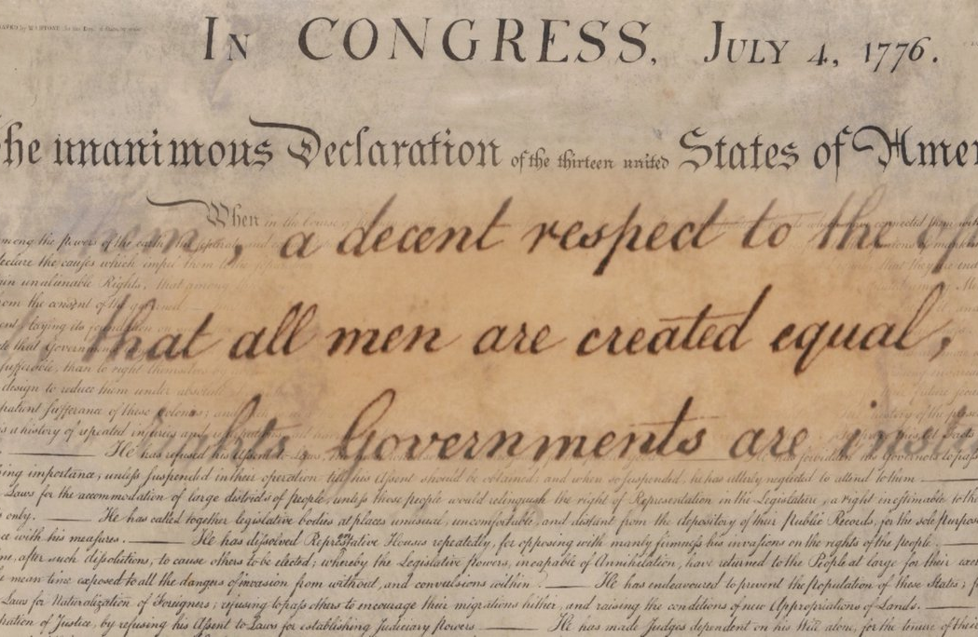
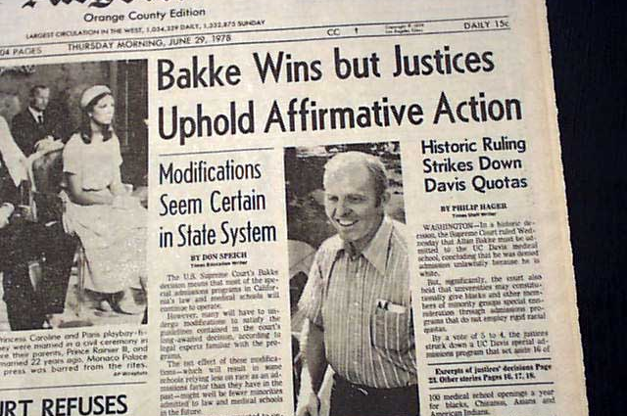
The Right to Equality
1776 v. 1976

Slide 3
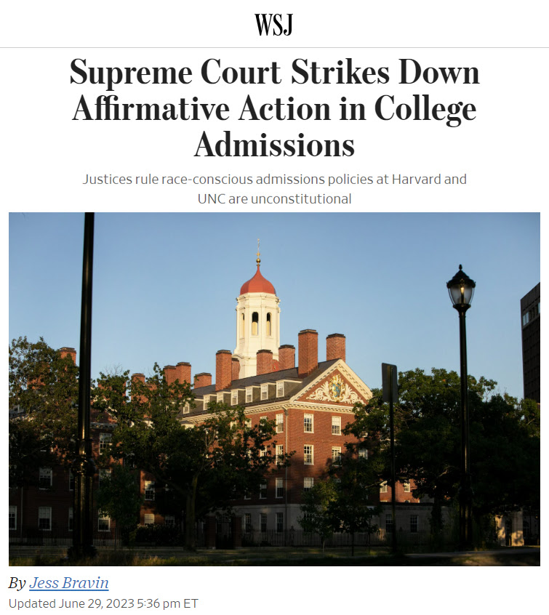
A Revolution in Equality
Students for Fair Admissions v. Harvard
Governments must be colorblind
“Diversity” never justifies discrimination
The rule of equality applies to private businesses also

Slide 4
35 days later…

Slide 5
Notes:
Students: 2021-2022 numbers
SNSP: 1,757
WPCP- 14,452
MPCP – 28,770
RPCP – 3,940
48,919
70,428 – public school open enrollment participation
49,678 - students attend a public charter school - https://dpi.wi.gov/sms/charter-schools/current
29,401- students are homeschooled in Wisconsin
Total: 198,426
Total school-age population: 997,408
About 20% of students attend an educational option that isn’t’ their assigned public school

Slide 6
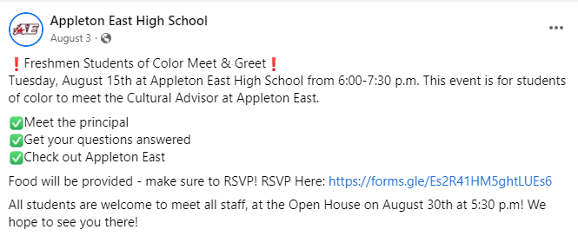
Notes:
Students: 2021-2022 numbers
SNSP: 1,757
WPCP- 14,452
MPCP – 28,770
RPCP – 3,940
48,919
70,428 – public school open enrollment participation
49,678 - students attend a public charter school - https://dpi.wi.gov/sms/charter-schools/current
29,401- students are homeschooled in Wisconsin
Total: 198,426
Total school-age population: 997,408
About 20% of students attend an educational option that isn’t’ their assigned public school

Slide 7
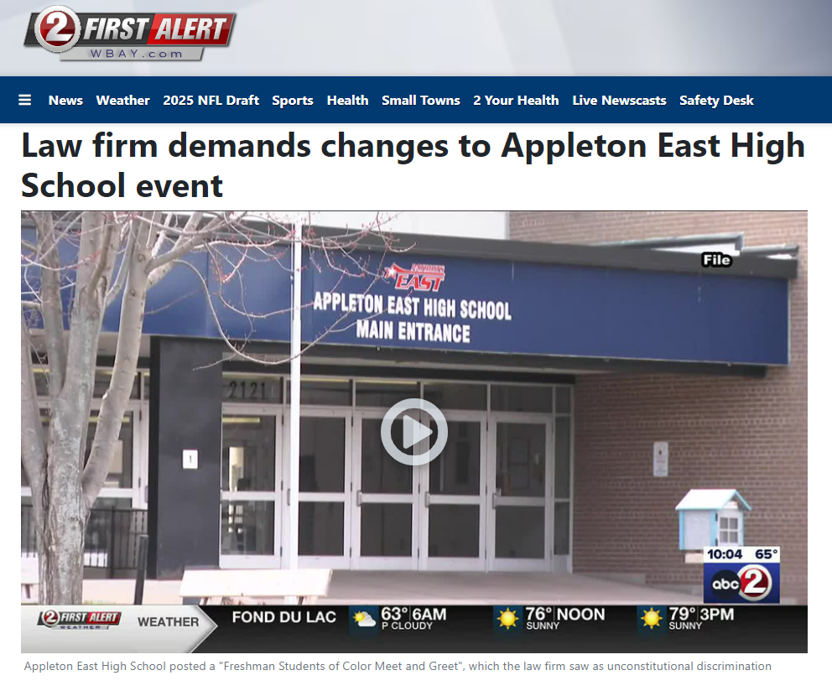
Notes:
Students: 2021-2022 numbers
SNSP: 1,757
WPCP- 14,452
MPCP – 28,770
RPCP – 3,940
48,919
70,428 – public school open enrollment participation
49,678 - students attend a public charter school - https://dpi.wi.gov/sms/charter-schools/current
29,401- students are homeschooled in Wisconsin
Total: 198,426
Total school-age population: 997,408
About 20% of students attend an educational option that isn’t’ their assigned public school

Slide 10
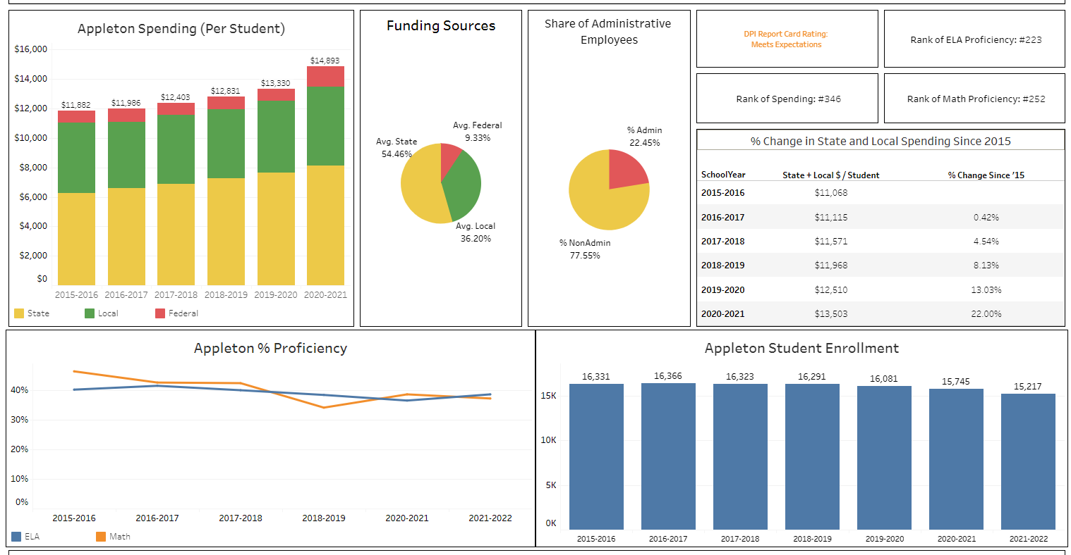

Slide 11
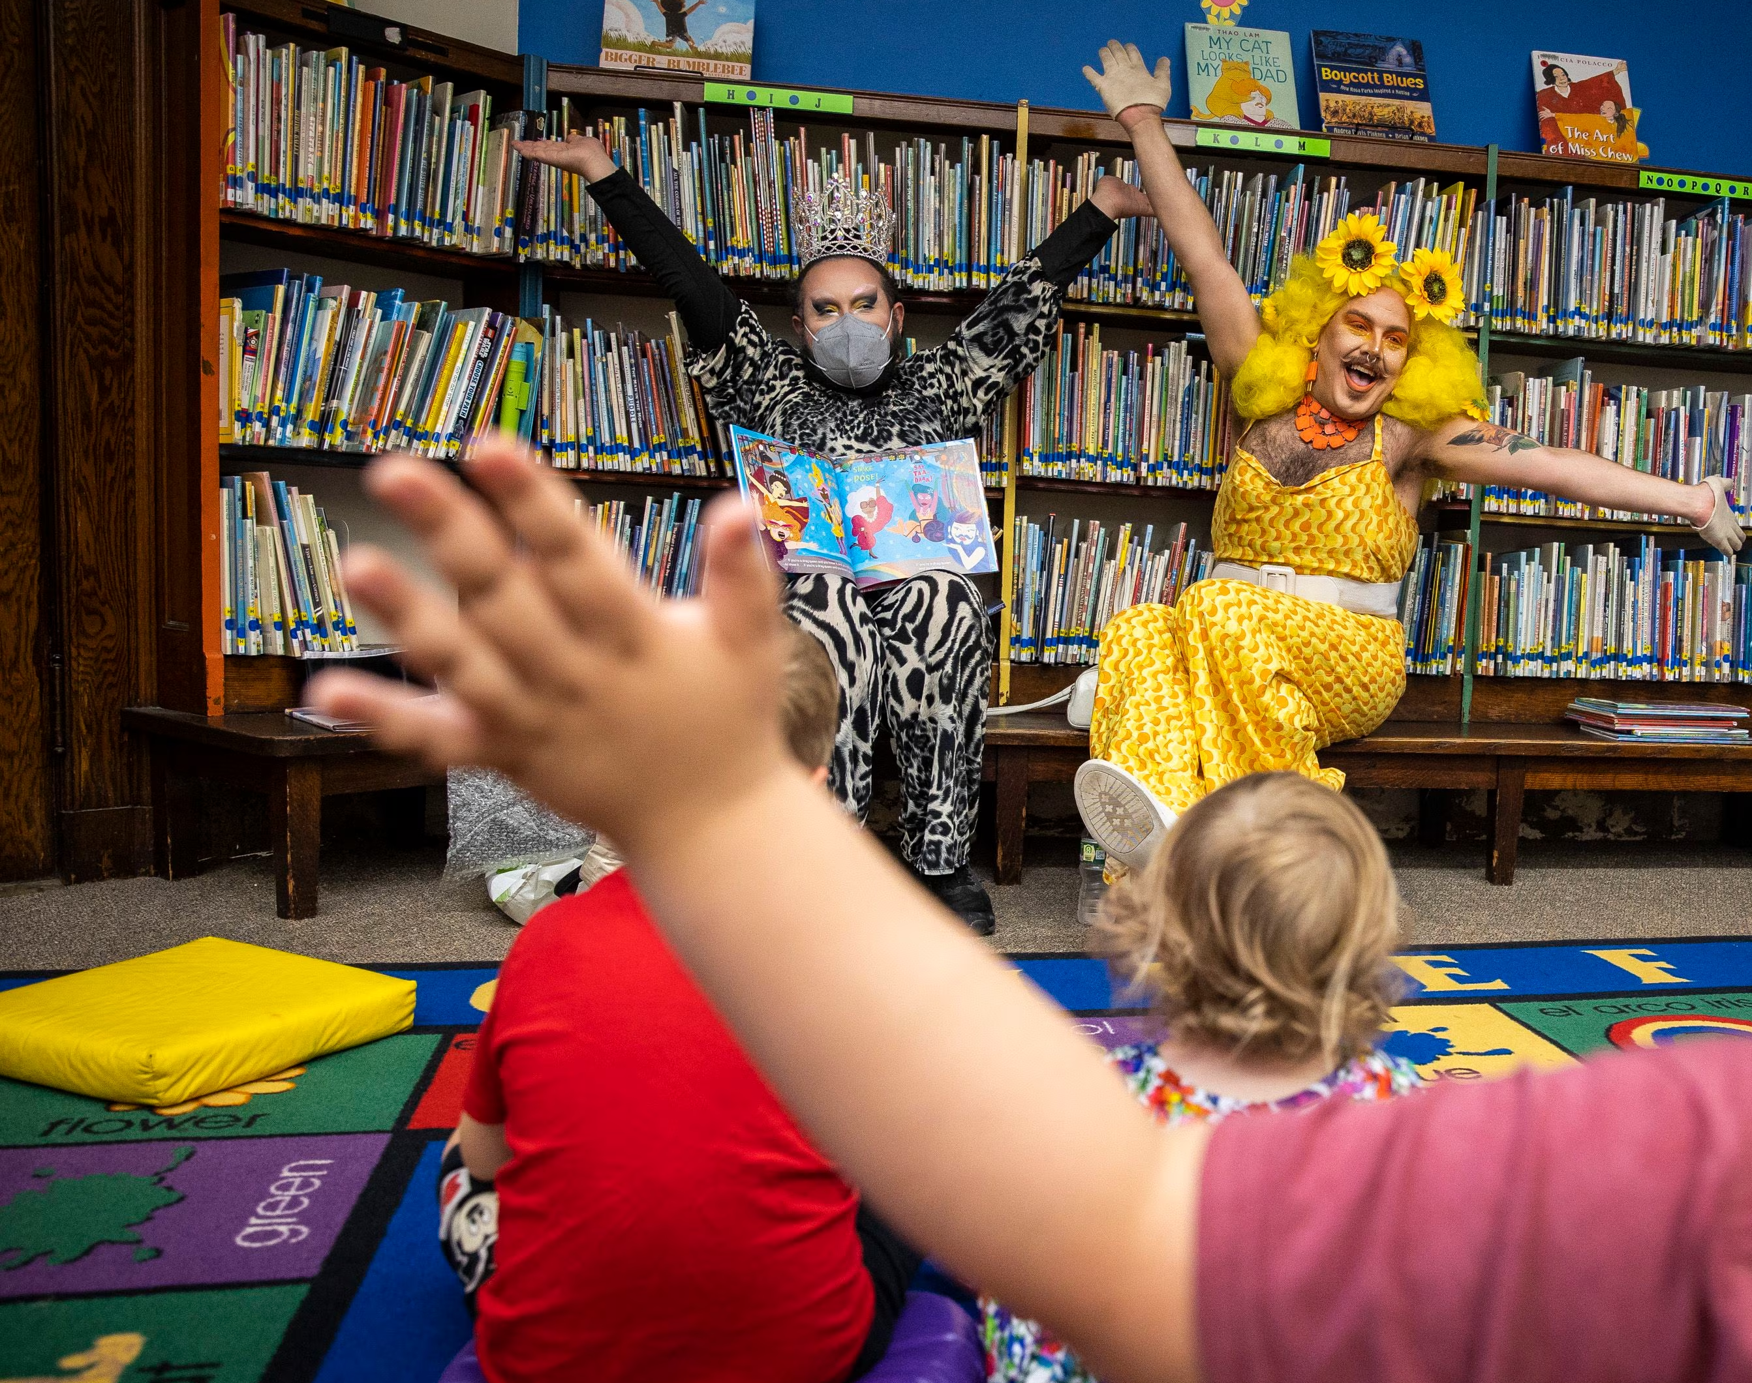
What’s going on in public schools?

Slide 12
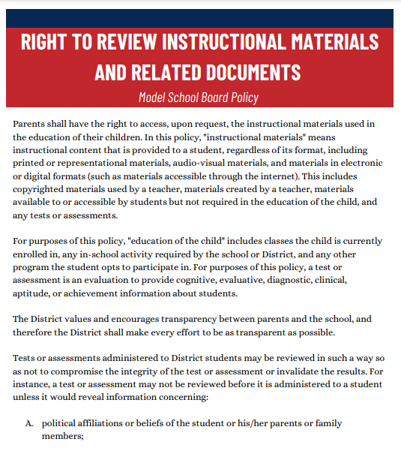
How can I find out what’s going on?
WILL-LAW.ORG
School Scorecards
School Board Model Policies
Public Records & Open Meetings
Know Your Rights In Public Schools
Lawsuits

Slide 13
Opt-Out:
Human Growth & Development
Opt-Out:
Surveys
Notification: CRT & Race Issues
Notes:
Math proficiency was approximately 4.8% lower in districts that were closed for in-person learning in Fall 2020.
This represents approximately 30% of all students in the state.

Slide 15
Questions Before Next Topic

Slide 17
14th Amendment
“No person shall …hold any office…who shall have engaged in insurrection or rebellion …”

Slide 18
14th Amendment
“Self-Executing”

Slide 19
14th Amendment
WEC
County Clerk (72)
Municipal Clerk (1850)
Presidential Preference Committee
Court case against clerk to prevent placement
Court case against clerk to order placement
House of Representatives
“Self-Executing”

Slide 20
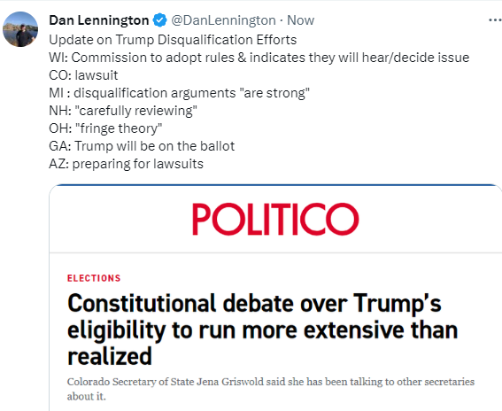
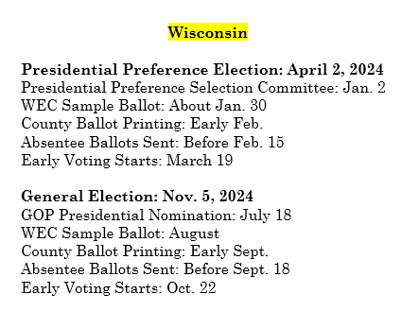
Be Aware and
Be Prepared

Slide 21
Contact WILL
Dan Lennington
dan@will-law.org
608-572-5358

