Slide 1
affiliated with Thomas More Society The Thomas More Society is a not-for-profit, national public interest law firm dedicated to restoring respect in law for life, family, and religious liberty. Based in Chicago, the Thomas More Society defends and fosters support for these causes by providing high quality pro bono legal services from local trial courts all the way to the United States Supreme Court.
Wisconsin Voter Alliance
Presented By:
Zakory Niemierowicz
Administrator
Wisconsin Voter Alliance
Thomas More Society
www.wisconsinvoteralliance.com

Slide 2
WVA has an effective approach in its post-2020 election investigations
WVA plays a critical role in the current Wisconsin Political environment with a republican Senate and Assembly and a Democrat Governor. Civil litigation is necessary!

Slide 3
What Wisconsin Voter Alliance did in 2020 and 2021
Filed complaint against Zuckerbucks prior to 2020 election
Partnered with the Thomas More Society
Filed many complaints to WEC and other election entities
Filed suits in Wisconsin 5 cities concerning drop boxes, eventually won all 5 cases
Created election integrity network with other groups
Launched Nursing Home Investigation
Started Investigation in ERIC/CEIR connections
Met with grassroots groups to discuss election topics
Assisted Wisconsin Special Counsel
Started a campaign to ban private grant money in elections
Submitted numerous Open Records requests to election representatives

Slide 4
WEC Mis-directions 2020
Saw the number of “indefinitely confined” (IC) voters rise to 272,000 from 46,000 in 2016
Decided that voters with IC status need no photo ID (May 13 directive)
Cured “carrier envelope” on absentee ballots
Allowed illegal “private money” to be injected into the election process “Zuckerbucks” BRIBERY? $36 in Green Bay, 57¢ on average elsewhere
The Elections Clause of the United States Constitution requires elections be funded by public funds
Allowed drop box use statewide

Slide 5
Have we corrected these 2020 miscues?
During the 2022 election season many steps were taken to correct the mistakes of 2020:
Drop boxes were eliminated statewide
Curing of absentee ballots was essentially eliminated
Indefinitely Confined list reduced to around 100,000 voters
Special Voting Deputies returned
Voters returning multiple absentee ballots, exception Green Bay Clerk Celestine Jeffries
WEC eliminated giving illegal advice
Partnering with Ryan Retza and the RNC poll workers were maximized
Outside financing was drastically reduced

Slide 6
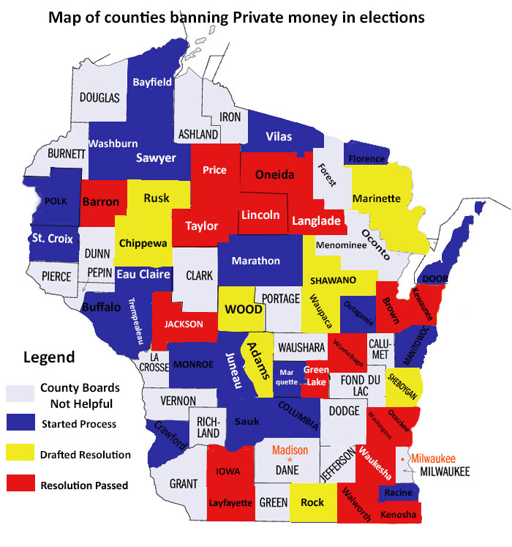
18 counties have already banned private grant money
9 counties have drafted resolutions and have brought them to the county board
21 counties have started the process to draft resolutions
24 counties will not draft resolutions or have been denied by the county boards.
Statewide ballot question during the spring Wisconsin Supreme Court election

Slide 7
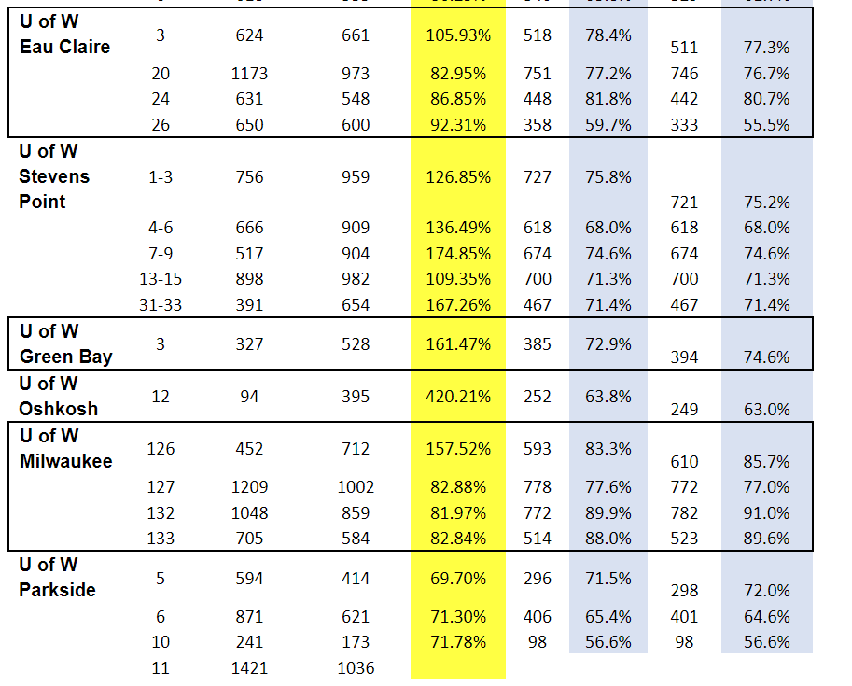
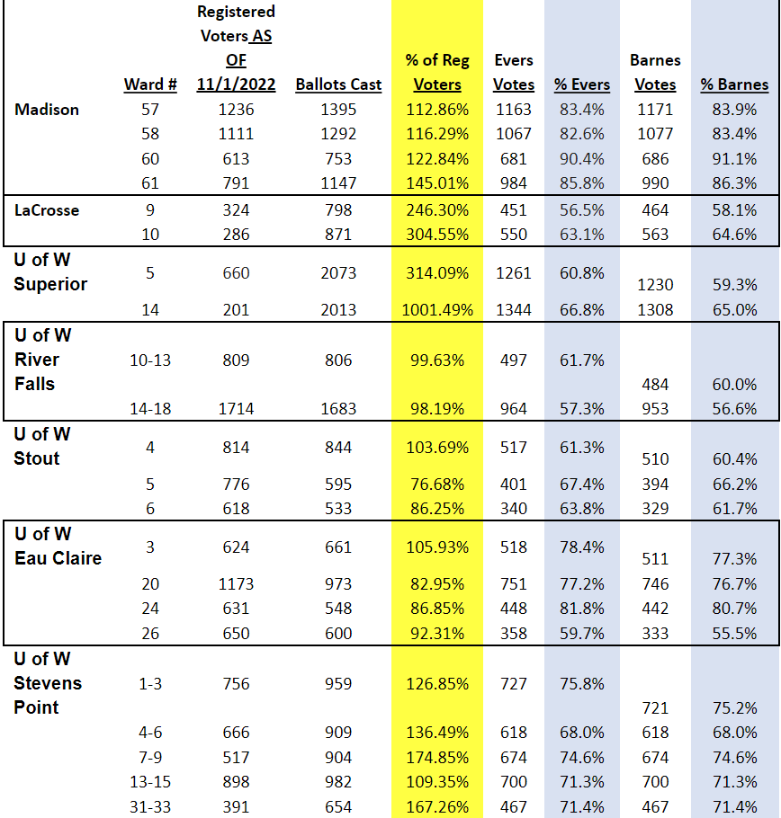
Democrat-Controlled 501c3s Control Campus Voting
Civic Center – All In Initiative
EDR, Voter Turnout, Party Voting

Slide 8
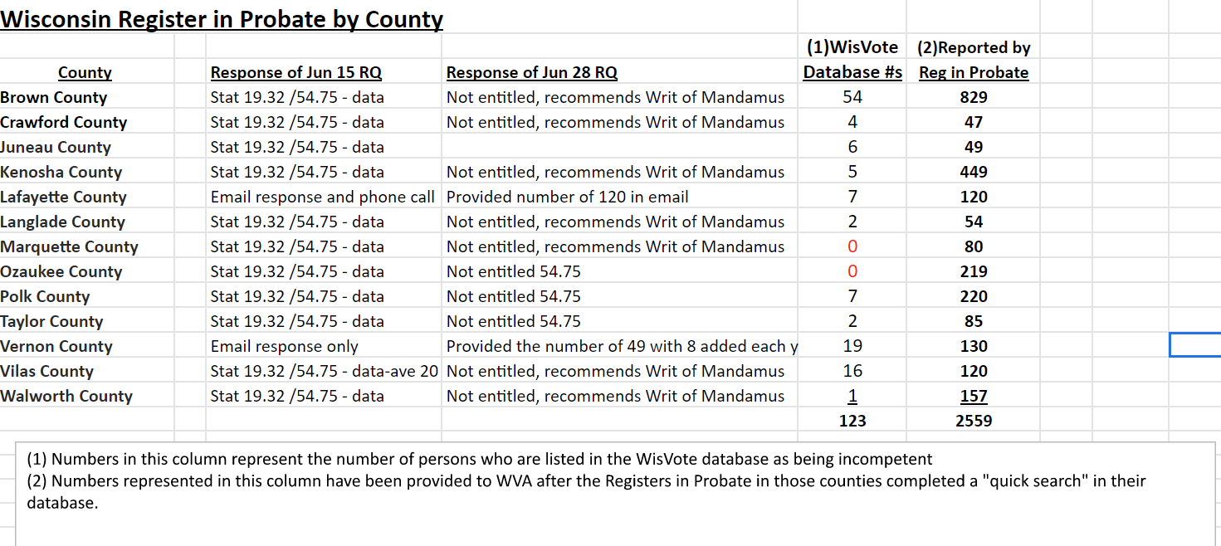
Incompetent Voter Investigation
Started with Walt Jankowski
Ron emailed all County Registers in Probate – 803 statewide
13 Registers in Probate originally responded with bewildering statistical differences

Slide 9
Incompetent Investigation Cont.
Steps to Adjudicate Next WVA Actions
Family applies
A judge administers competency test
Judge will order for individual to maintain voting rights or not
CCAP GN3170 form is completed by Probate, sent to WEC
Confusion begins on what happens next, some labeled Incompetent / Inactive
Requested 13 Registers in Probate provide GN3170 forms – created in 2013 by DOJ to follow confidentiality
Registers in Probate refuse
WVA files 13 lawsuits in the 13 counties from which preliminary numbers were received
WEC releases letter pointing blame at clerks, while changing Incompetent/Inactive to Administrative Action without approval
Juneau County prematurely denies case, WVA files appeal
11 motions to stay granted
Judge in Walworth County case rules against WVA, WVA files appeal

Slide 10
Military Absentee Ballot Case
Kim Zapata orders 3 ballots to be sent to Rep. Janel Brandtjen
Janel receives ballots and raises the alarm
Kim Zapata admits to her actions, is fired, and is charged with election fraud
Concerned Veterans of Waukesha County vs. WEC
WEC denies complaint, asks why we haven't filed against clerks
WVA and TMS file case against Amy Dashinger – Menominee Falls Clerk

Slide 11
What Will WVA Tackle in 2023?
Continue Nursing Home Investigations including Incompetent Voters
Continue with our litigation of data-sharing: Help America Vote Act (HAVA) complaints as well as Driver’s Privacy Protection act (DPPA) complaints in Wisconsin, Pennsylvania, Michigan, and Minnesota
Support statewide referendum banning private grant money
Build rapport with, and continue work with Assembly and Senate to:
Push for re-engineering WEC
Recommend, when appropriate, new legislation (Nursing Homes)
Continue to investigate campus spending and illegalities involved
Continue to pursue Military Absentee Ballot Issues
WVA is now a 501c3 – build membership, fund raising, etc.
www.wisconsinvoteralliance.com

Slide 12
THANK YOU FOR YOUR ATTENTION
www.wisconsinvoteralliance.com

